Slide 1
Java Arrays

Slide 2
Java Arrays
Arrays are used to store multiple values in a single variable, instead of declaring separate variables for each value.
To declare an array, define the variable type with square brackets:
String[] cars;

Slide 3
Java Arrays
We have now declared a variable that holds an array of strings. To insert values to it, we can use an array literal place the values in a comma-separated list, inside curly braces:
String[] cars = {"Volvo", "BMW", "Ford", "Mazda"};
To create an array of integers, you could write:
int[] myNum = {10, 20, 30, 40};

Slide 4
Access the Elements of an Array
You access an array element by referring to the index number.
This statement accesses the value of the first element in cars:
Example:
String[] cars = {"Volvo", "BMW", "Ford", "Mazda"};
System.out.println(cars[0]);
// Outputs Volvo

Slide 5
Change an Array Element
To change the value of a specific element, refer to the index number:
Example:
cars[0] = "Opel";

Slide 6
Array Length
To find out how many elements an array has, use the length property:
Example:
String[] cars = {"Volvo", "BMW", "Ford", "Mazda"};
System.out.println(cars.length);
// Outputs 4

Slide 7
Loop Through an Array
You can loop through the array elements with the for loop, and use the length property to specify how many times the loop should run.
The following example outputs all elements in the cars array:
Example
String[] cars = {"Volvo", "BMW", "Ford", "Mazda"};
for (int i = 0; i < cars.length; i++) {
System.out.println(cars[i]);
}

Slide 8
Loop Through an Array with For-Each
There is also a "for-each" loop, which is used exclusively to loop through elements in arrays:
Syntax
for (type variable : arrayname) {
...
}

Slide 9
Multidimensional Arrays
A multidimensional array is an array of arrays.
To create a two-dimensional array, add each array within its own set of curly braces:
Example
int[][] myNumbers = { {1, 2, 3, 4}, {5, 6, 7} };

Slide 10
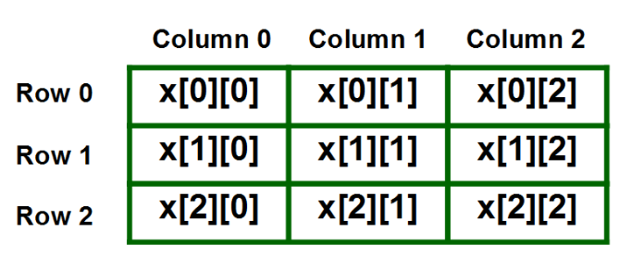
Multidimensional Arrays
Representation of 2D array in Tabular Format: A two – dimensional array can be seen as a table with ‘x’ rows and ‘y’ columns where the row number ranges from 0 to (x-1) and column number ranges from 0 to (y-1). A two – dimensional array ‘x’ with 3 rows and 3 columns is shown below:

